Slide 1
HND Computing Systems Development: Object Oriented Analysis and Design (H172 35)
Lecturer – Dawn Wilson

Slide 2
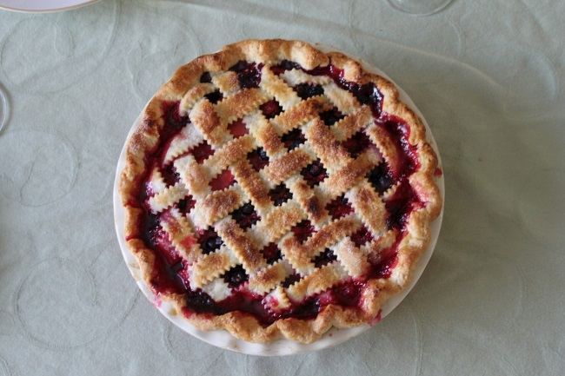
4 Pillars of OO
“A PIE”
Abstraction
Polymorphism
Inheritance
Encapsulation

Slide 3
4 Pillars of OO
Abstraction – attributes/methods that are completely separate from any specific instance
Generalisation – focus on the essentials
Encapsulation – keep contents together and protect them
Only reveal what is necessary for other parts of the application to work
Inheritance - derive a new class from an existing one
Code re-use, avoid redundancy, easy to modify
Polymorphism - A child class can override the definition of an inherited method in favor of its own

Slide 4
OO Design Process
Need to follow a process to identify the classes/objects for our application:
Gather requirements
Describe the application
Identify the main objects
Describe the interactions
Create a class diagram

Slide 5
Gather Requirements
Analysis
Functional – what is it required to do i.e. features/capabilities
Non-functional – what else? i.e. Security, performance, documentation
To formally gather requirements…
FURPS / FURPS+
Functional requirements, Usability requirements, Reliability requirements, Performance requirements, Supportability requirements
+ design requirements, implementation requirements, interface requirements, physical requirements
N.B. agile approach – first pass, grab minimal set of requirements to feed into next part of the process. Some requirements will be TBD and will be defined later

Slide 6
User Focus
Now we have our requirements i.e. application must do …
Need to focus on the USER – how does the user accomplish a particular goal?
2 formats typically used for this purpose
User story
Use case

Slide 7
User Story
Describes a single goal from the users perspective
What do they want to do and why?
1 or 2 sentences typically written on index cards
Follows a particular format:
As a (type of user)
I want (goal)
so that (reason) this part is optional
e.g.
As a bank customer
I want to change my PIN online
so that I don’t have to go into a branch
Notes:
Stakeholders write user stories. An important concept is that your project stakeholders write the user stories, not the developers. User stories are simple enough that people can learn to write them in a few minutes, so it makes sense that the domain experts (the stakeholders) write them.

Slide 8
Activity
Write user stories for a doctors surgery management system

Slide 9
User Story
Done at the start of the project as a placeholder for future conversation and as a reminder that we need to discuss…
SCRUM/XP would use User Stories
Always used as input for next stage in process

Slide 10
Use Case
A Use Case is a record of conversation that has happened and details particular steps for goal
Full formal process would use Use Cases
User Stories Use Cases
short - 1 index card long – a document
one goal, no details multiple goals and details
informal casual to formal
“placeholder” “record”
Always used as input for next stage in process

Slide 11
Use Case – what details are captured?
Title: what is the goal?
Short phrase with active verb e.g. register new member, transfer funds
Actor: who desires it?
Who is having this interaction? e.g. customer, member, ACME system (non-human)
Scenario: how is it accomplished?
As a paragraph, details of accomplishing a goal step-by-step. Could write a numbered list of steps BUT remember this is NOT pseudocode!
extensions – for alternative flows i.e. when situation does not follow “normal” e.g. item out of stock
precondition – add a precondition to the scenario e.g. must have minimum of 1 item in shopping cart
postconditions, triggers, stakeholders
N.B. too much detail could kill progress, need to enough to progress to next stage

Slide 12
How do we identify potential use cases?
Constantine and Lockwood (1999) suggest asking your stakeholders the following questions from the point of view of the actors:
What are users in this role trying to accomplish?
To fulfil this role, what do users need to be able to do?
What are the main tasks of users in this role?
What information do users in this role need to examine, create, or change?
What do users in this role need to be informed of by the system?
What do users in this role need to inform the system about?
Constantine L.L. & Lockwood L.A.D. (1999). Software for Use: A Practical Guide to the Models and Methods of Usage-Centered Design. 1st ed. New York: Addison-Wesley

Slide 13
Use case – identifying the actors
Actor – anything with behaviour that lives outside of the application but has a goal they wish to accomplish
Does your app. need to interact with any external system or organisation?
For human actors – do you need to distinguish between roles/security groups? E.g. visitor, member, admin, owner
Think about job titles, departments e.g. data entry staff, security team
Might be the case that multiple different types of employees may need the same use case i.e. want to achieve the same goal and no difference between each therefore have a single Actor generically called “The requestor” or “The approver”

Slide 14


Identifying the scenario
A goal an Actor can accomplish in a single encounter (may be several steps) e.g. checking out shopping is part of an overall goal and not a use case in it’s own right
Use cases can have multiple scenarios
normal “sunny day” scenario
Extensions – alternative paths. Don’t think about bizarre events, just typical events that may occur
Choose readability and ease of creation over formality
system connects to external payment process over
HTTPS and uses JSON to submit the payment
system validates payment information

Slide 15
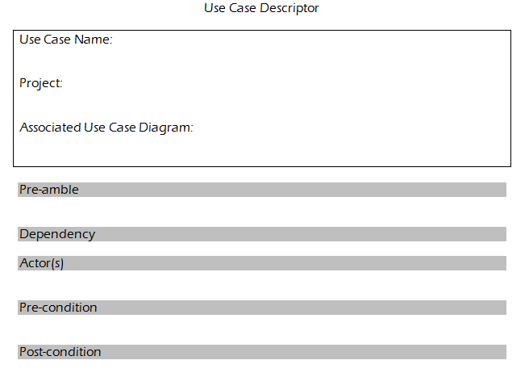

Documenting a Use Case

Slide 16

Remaining Agile
It is very easy for use case modelling to become un-agile. To prevent this from happening you need to focus on creating artefacts that are just barely good enough, they don't need to be perfect.
Just need enough detail to move forward
Be agile, be lean, don't be afraid to make mistakes.
Strongly written use cases with a few mistakes is FAR better than an over complicated detailed list that confuses and bores an audience

Slide 17
Activity
Write use cases for a doctors surgery management system

Slide 18
Diagramming Use Cases
UML Use Case diagram
Diagram multiple use cases and actors together to give an overview of the system and how they interact in context
Stick figures to represent an actor
Elipses around use case titles
Rectangle around all use cases to show system boundary (can also be useful to use boxes to denote releases)
Draw lines (association) between actors and use cases they interact with
If actor supplies information, initiates the use case, or receives information as a result of a use case then need an association
N.B. this does not represent flow of information therefore no arrow heads (information flow can be modelled using UML activity diagrams)

Slide 19
Diagramming Use Cases
Not all actors are humans, may be an external system. This should be represented by a box (rather than a stick figure), but include the notation <<actor>> at the top of the box
Typically (not a rule), put primary actors (initiate use case) on the left hand side and secondary actors on right
There is no sequence of use cases, but if the app. has a flow then can diagram them top to bottom
It is a simple overview of multiple actors and use cases at the same time without any specific details. Good for communication and assists with identifying missing actors/use cases

Slide 20
Linking Use Cases
Association relationships
Generalization relationships
One element (child) "is based on" another element (parent)
Include relationships
One use case (base) includes the functionality of another (inclusion case)
Supports re-use of functionality
Extend relationships
One use case (extension) extends the behaviour of another (base)

